Slide 1
PROJECT TITLE SECURE DATA HIDING IN IMAGES USING STAGANOGRAPHY
CAPSTONE PROJECT
Presented By: ROHIT KUMAR VISHWAKARMA
College Name & Department : MAULANA AZAD NATIONAL INSTITUTE OF TECHNOLOGY ,BHOPAL (M.P) , DPT- MECHANICAL ENGINEERING

Slide 2
OUTLINE
Problem Statement
Technology used
Wow factor
End users
Result
Conclusion
Git-hub Link
Future scope

Slide 3
Problem Statement
In the digital age, secure communication is a critical concern. Traditional encryption methods can attract attention, making sensitive data vulnerable to attacks. Steganography provides a solution by embedding secret messages within images in a way that is visually undetectable. This project aims to implement image-based steganography using OpenCV to hide and retrieve confidential messages securely.

Slide 4
Technology used
Programming Language: Python 3.x
Library: OpenCV (cv2)
Data Structure: Dictionary-based character encoding
Storage Medium: Image pixels (RGB channels)
Operating System Compatibility: Windows/Linux
Execution: Command-line interface (CLI)

Slide 5
Wow factors
✅ Invisible Message Encoding: Data is stored within the image without altering its visual appearance.
✅ Secure Decryption: Message retrieval is possible only with the correct passcode.
✅ Lightweight & Fast: No external database or heavy dependencies required.
✅ Customizable: Can be extended to different file formats and encryption techniques.

Slide 6
End users
👨‍💻 Cybersecurity Professionals: To transmit confidential data securely.
🔐 Government Agencies: For classified communication.
🛡 Journalists & Activists: To protect sensitive information.
📜 Academicians & Researchers: For secure watermarking and data hiding.

Slide 7
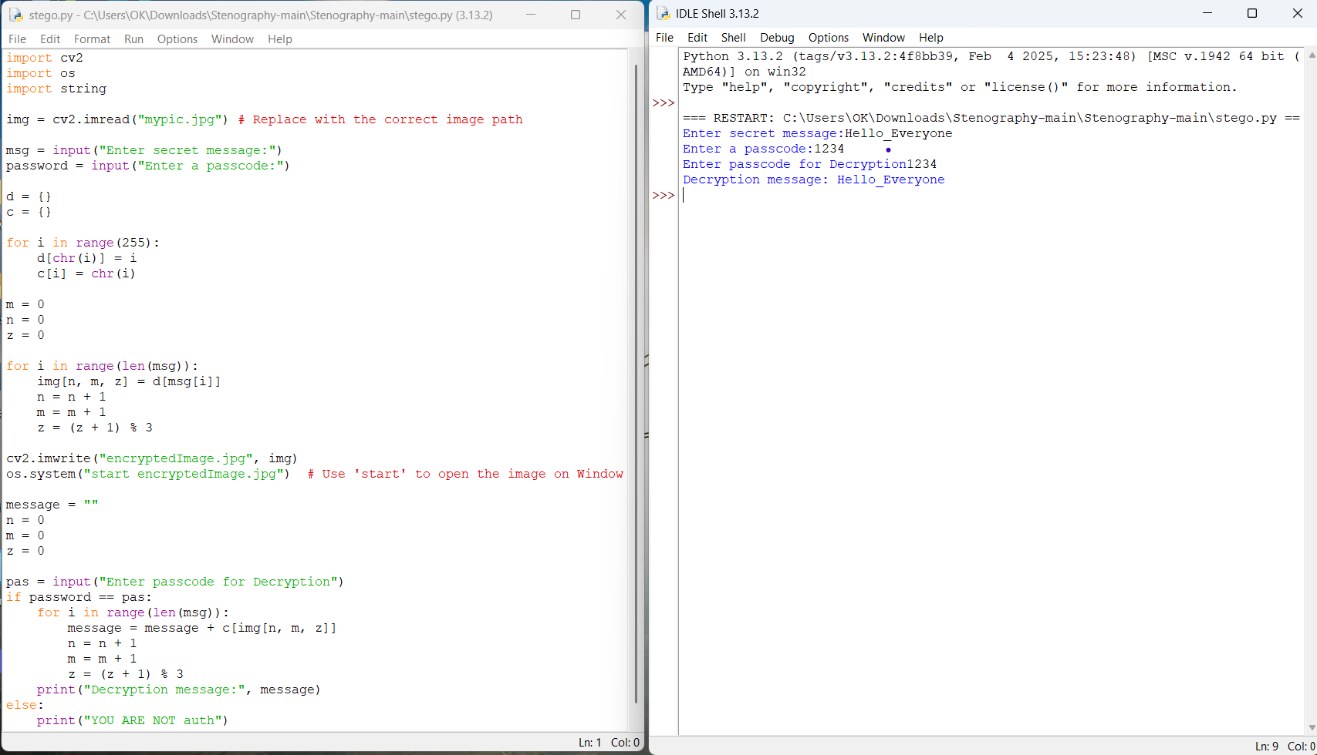
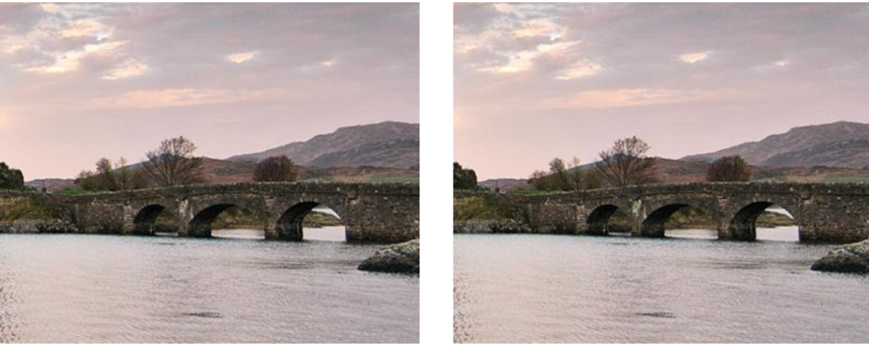













Results :- CODE Result

Slide 8
Conclusion
This project demonstrates an effective and simple way to implement image steganography using OpenCV. By leveraging pixel manipulation, users can securely hide messages within an image, ensuring covert communication. The implementation is efficient, with minimal computational overhead, making it a practical tool for secure data transfer.

Slide 9
GitHub Link
Link
🔗
https://github.com/ROHIT-ONGIT/aicte-steganography-project

Slide 10
Future scope(optional)
🚀 Advanced Encryption: Integrate AES/RSA encryption for added security.
🎨 Multi-Format Support: Extend to PNG, BMP, and GIF file types.
🖼 Steganography in Videos: Hide data inside video frames.
📡 Network Steganography: Implement message hiding in network packets.
📲 Mobile App Integration: Develop an Android/iOS version for steganography on the go.

Slide 11
THANK YOU

